Slide 1
Data Science Visualization
March 2024

Slide 2
Agenda
Data Visualization Introduction
Matplotlib
Seaborn

Slide 3
Data Visualization
Introduction
Data visualization which is the process of translating the numbers, text, or large data sets into various types of graphs.
It helps us understand complex data relationships, identify patterns, trends, and outliers easily.
It also helps communicate information to a wider audience, even those without a technical background.

Slide 4
Data Visualization
Benefits of Data Visualization
Data visualization also provide several benefits, including:
Makes complex data easier to understand: Allows people to see patterns and trends that might be difficult to identify in a spreadsheet or table.
Improves communication: Can be a powerful tool for communicating complex information to a wider audience. Helps to tell a story with data and make it more engaging for viewers.
Helps identify patterns and trends: Helps us to see patterns and trends in data that we might not have noticed otherwise. Can also be helpful for making predictions and informed decisions.
Saves time: Helps to save us time by allowing us to quickly see the key points in a data set. Can be helpful if dealing with large sets of data.

Slide 5

Matplotlib
Introduction
Matplotlib is a low level graph plotting library in python that serves as a visualization utility.
It is able to create different types of visualization reports like line plots, scatter plots, histograms, bar charts, and pie charts.
This library also supports 3-dimensional plotting.

Slide 6
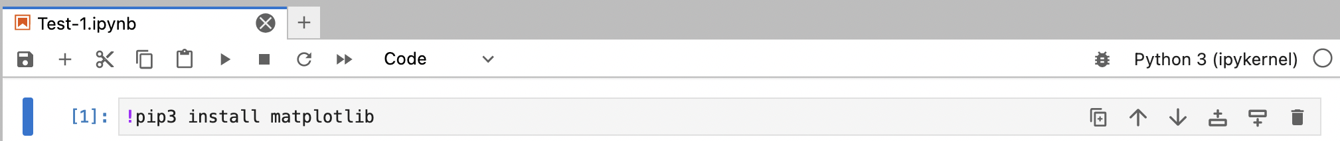
Matplotlib
Installation
Install matplotlib using pip:
pip3 install matplotlib

Slide 7
Matplotlib
Installation
Check matplotlib version:
import matplotlib
print(matplotlib.__version__)

Slide 8
Matplotlib
Pyplot
Most of the Matplotlib utilities lies under the pyplot submodule, and are usually imported under the plt alias:
Example:
#1st import method
from matplotlib import pyplot as plt
#2nd import method
import matplotlib.pyplot as plt
#basic plotting, first array for x-axis, second array for y-axis
plt.plot([1,2,3], [1,2,3])
#show plot
plt.show()

Slide 9
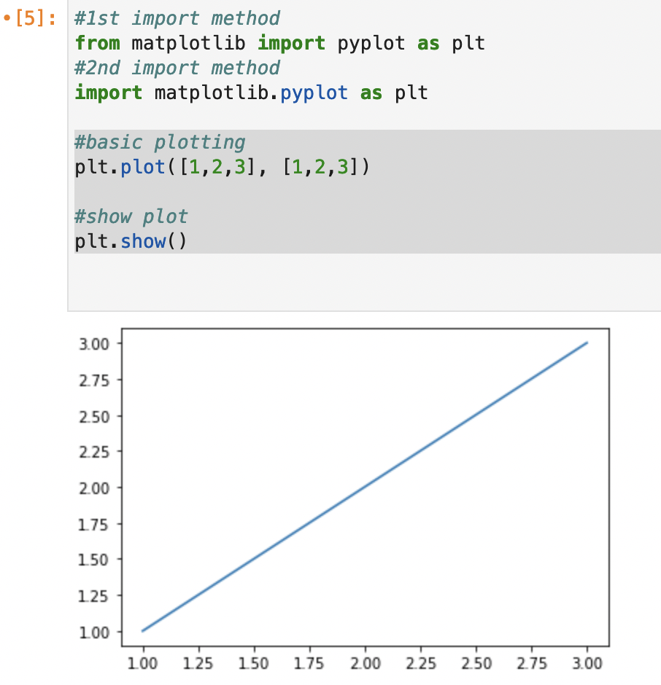
Matplotlib
Pyplot

Slide 10
Matplotlib
Pyplot
Plotting X and Y Points
The plot() function is used to draw points (markers) in a diagram.
By default, the plot() function draws a line from point to point.
The function takes parameters for specifying points in the diagram.
Parameter 1 is an array containing the points on the x-axis.
Parameter 2 is an array containing the points on the y-axis.

Slide 11
Matplotlib
Pyplot
Example:
import matplotlib.pyplot as plt
import numpy as np
xpoints = np.array([1, 10])
ypoints = np.array([1, 5])
plt.plot(xpoints, ypoints)
plt.show()

Slide 12
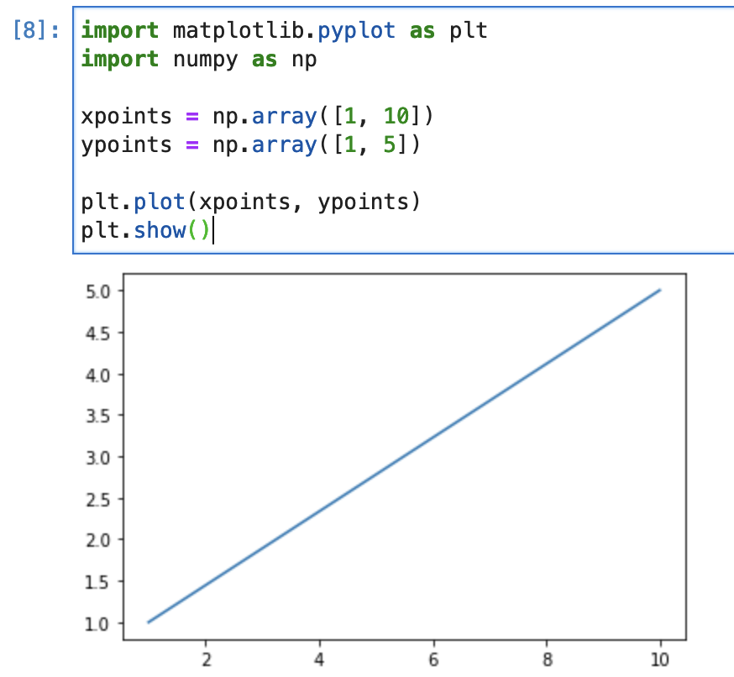
Matplotlib
Pyplot

Slide 13
Matplotlib
Pyplot
Markers
Use the keyword argument marker to emphasize each point with a specified marker:
List of marker: https://matplotlib.org/stable/api/markers_api.html
Example:
import matplotlib.pyplot as plt
import numpy as np
xpoints = np.array([1, 3, 5, 10])
ypoints = np.array([1, 7, 3, 10])
#use marker ‘o’
plt.plot(xpoints, ypoints, marker = 'o')
plt.show()

Slide 14
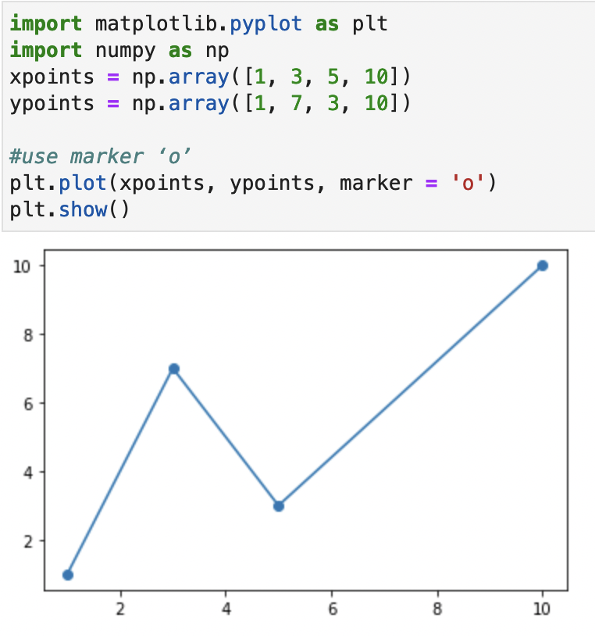
Matplotlib
Pyplot

Slide 15
Matplotlib
Line Plot
Linestyle
Use the keyword argument linestyle, or shorter ls, to change the style of the plotted line
List of linestyle: https://matplotlib.org/stable/gallery/lines_bars_and_markers/linestyles.html
Example:
import matplotlib.pyplot as plt
import numpy as np
xpoints = np.array([1, 3, 5, 7, 10])
ypoints = np.array([1, 10, 10, 15, 20])
#use dotted linestyle
plt.plot(xpoints, ypoints, marker = '*', ls = 'dotted')
plt.show()

Slide 16
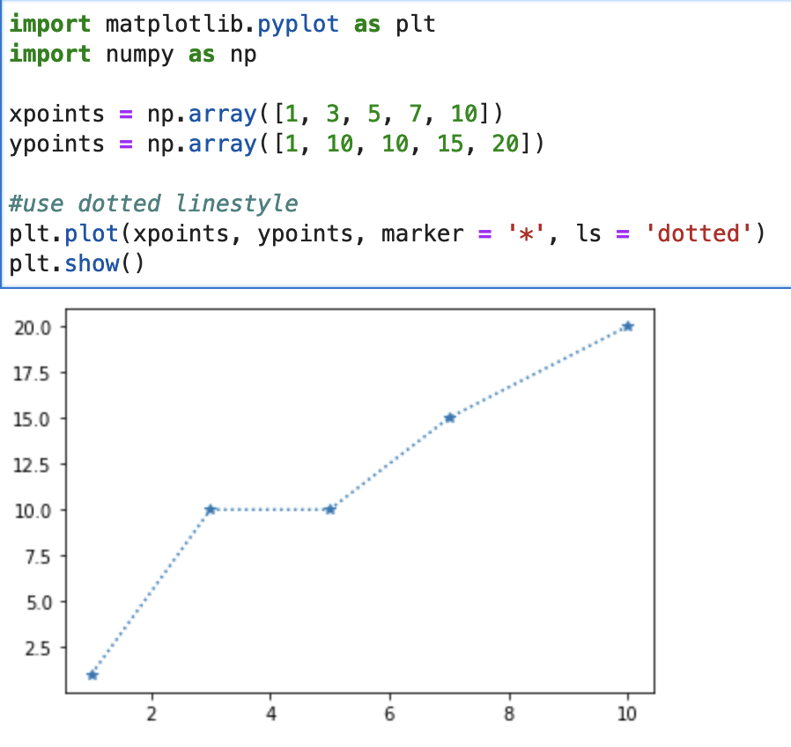
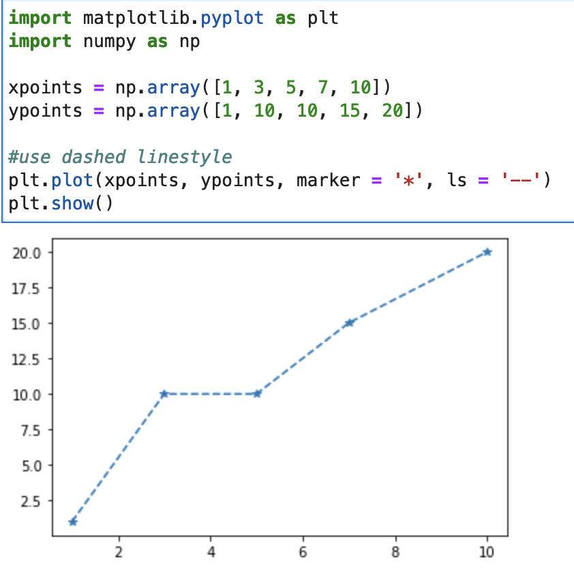
Matplotlib
Line Plot

Slide 17
Matplotlib
Line Plot
Color
Use the keyword argument color or the shorter c to set the color of the line:
List of color name: https://matplotlib.org/stable/gallery/color/named_colors.html
List of color code: https://htmlcolorcodes.com/
Example:
import matplotlib.pyplot as plt
import numpy as np
xpoints = np.array([1, 3, 5, 7, 10])
ypoints = np.array([2, 10, 10, 10, 5])
#use pink color
plt.plot(xpoints, ypoints, marker = '*', ls = 'dashdot', c = 'pink')
plt.show()

Slide 18
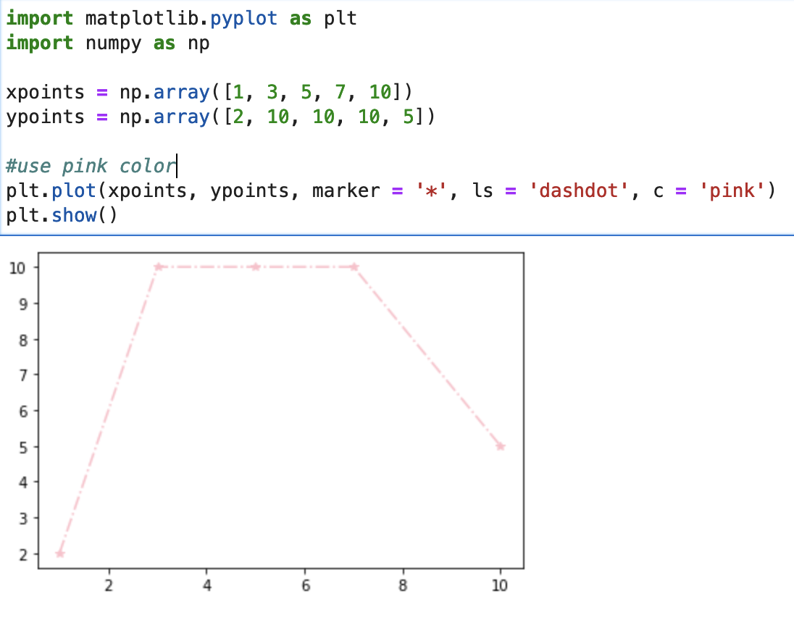
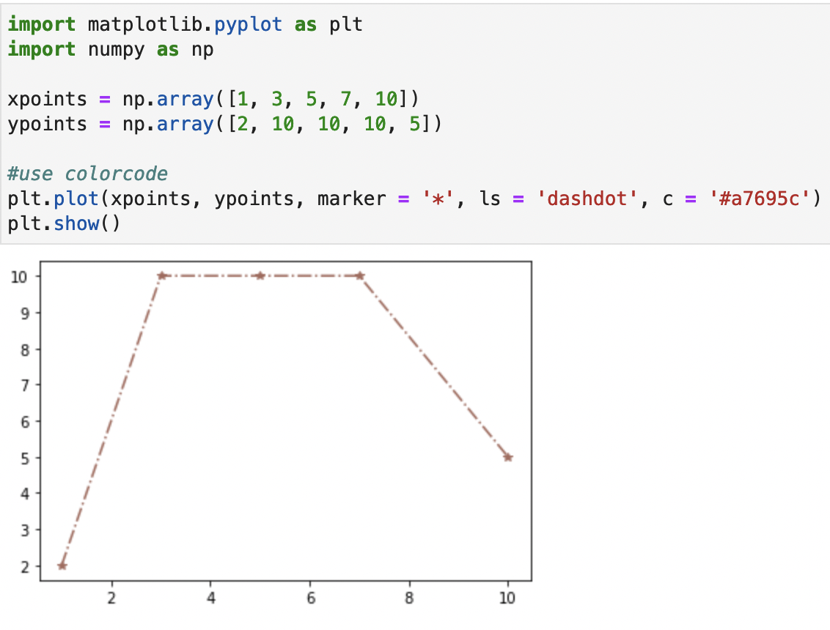
Matplotlib
Line Plot

Slide 19
Matplotlib
Line Plot
Linewidth
Use the keyword argument linewidth or the shorter lw to change the width of the line.
Example:
import matplotlib.pyplot as plt
import numpy as np
xpoints = np.array([1, 5, 9, 7, 10])
ypoints = np.array([2, 11, 6, 3, 20])
#use linewidth size 10
plt.plot(xpoints, ypoints, marker = 'P', c = 'green', lw = 10)
plt.show()

Slide 20
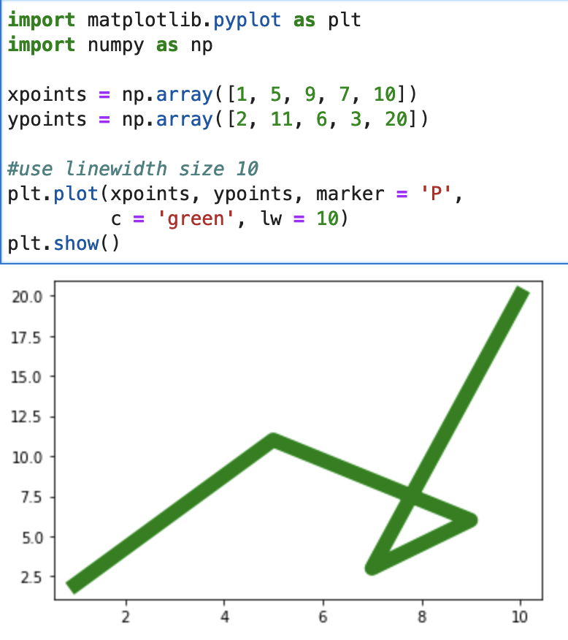
Matplotlib
Line Plot

Slide 21
Matplotlib
Line Plot
Multiple Lines
Plot as many lines as you like by simply adding more plt.plot() functions.
Example:
import matplotlib.pyplot as plt
import numpy as np
#set array parameter
y1 = np.array([3, 8, 1, 10, 15])
y2 = np.array([6, 2, 7, 11, 8])
y3 = np.array([2, 5, 8, 11, 14])
#plot parameter
plt.plot(y1)
plt.plot(y2)
plt.plot(y3)
plt.show()

Slide 22
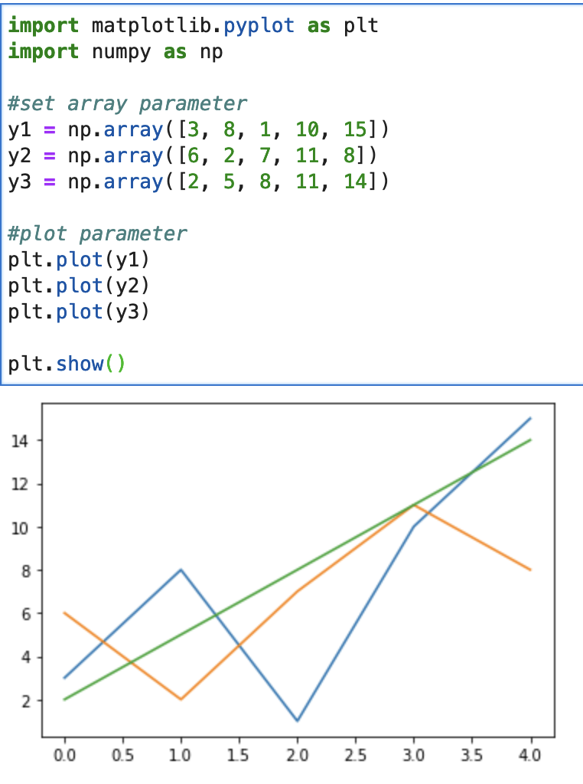
Matplotlib
Line Plot

Slide 23
Matplotlib
Line Plot
Create Labels and Title for a Plot
With Pyplot, use the xlabel() and ylabel() functions to set a label for the x- and y-axis.
Use the title() function to set a title for the plot.

Slide 24
Matplotlib
Line Plot
Example:
import numpy as np
import matplotlib.pyplot as plt
x = np.array([2, 4, 6, 8, 10])
y = np.array([1, 2, 3, 3, 4])
plt.plot(x, y, marker = 'P', ls = 'dashed',
c = 'green')
#plot title
plt.title("Player Performance")
#label x-axis
plt.xlabel("Games Played")
#label y-axis
plt.ylabel("Goals")
plt.show()

Slide 25
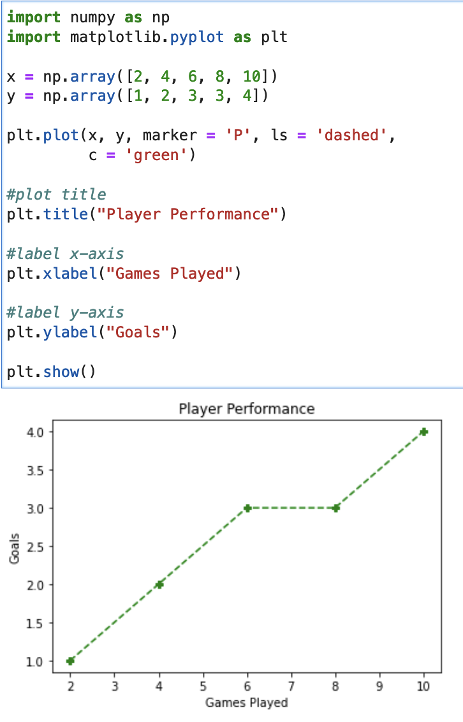
Matplotlib
Line Plot

Slide 26
Matplotlib
Line Plot
Font
Use the fontdict parameter in xlabel(), ylabel(), and title() to set font properties for the title and labels.
Example:
#set font
font1 = {'family’:’sans-serif','color':'brown','size':20}
font2 = {'family':'serif','color':'red','size':15}

Slide 27
Matplotlib
Line Plot
#set font
font1 = {'family':'italic','color':'brown','size':20}
font2 = {'family':'serif','color':'red','size':15}
#plot title
plt.title("Player Performance", fontdict= font1)
#label x-axis
plt.xlabel("Games Played", fontdict= font2)
#label y-axis
plt.ylabel("Goals", fontdict= font2)
plt.show()
Full Example:
import numpy as np
import matplotlib.pyplot as plt
x = np.array([2, 4, 6, 8, 10])
y = np.array([1, 2, 3, 3, 4])
plt.plot(x, y, marker = 'P', ls = 'dashed',
c = 'green')

Slide 28
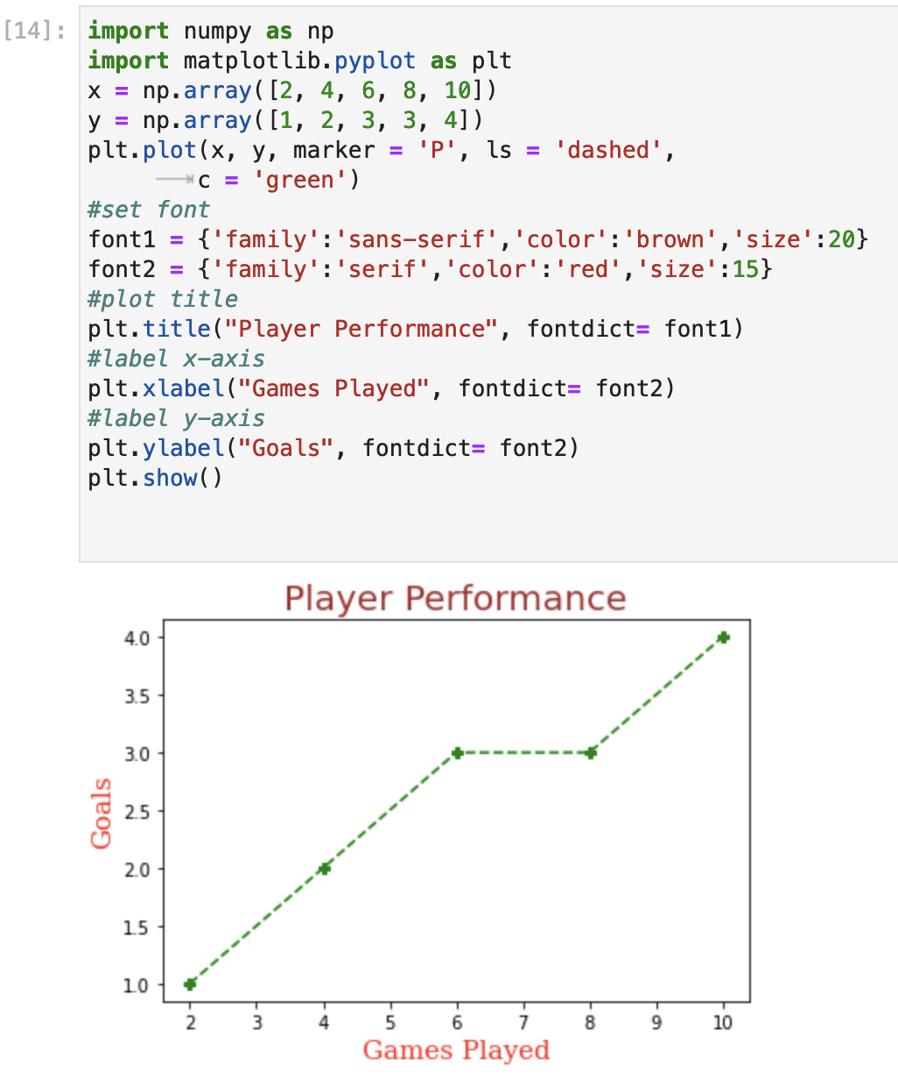
Matplotlib
Line Plot

Slide 29
Matplotlib
Line Plot
Grid
With Pyplot, use the grid() function to add grid lines to the plot.
Example:
import numpy as np
import matplotlib.pyplot as plt
x = np.array([2, 4, 6, 9, 10])
y = np.array([1, 2, 2, 2, 4])
plt.plot(x, y, marker = '+', ls = 'dotted',
c = 'purple')
#set font
font1 = {'family’:’sans-serif','color':'brown','size':20}
font2 = {'family':'serif','color':'red','size':15}
#plot title
plt.title("Player Performance", fontdict= font1, loc= 'left')
#label x-axis
plt.xlabel("Games Played", fontdict= font2)
#label y-axis
plt.ylabel("Goals", fontdict= font2)
#add grid to the graph
plt.grid(color = 'green', linestyle = '--', linewidth = 0.5)
plt.show()

Slide 30
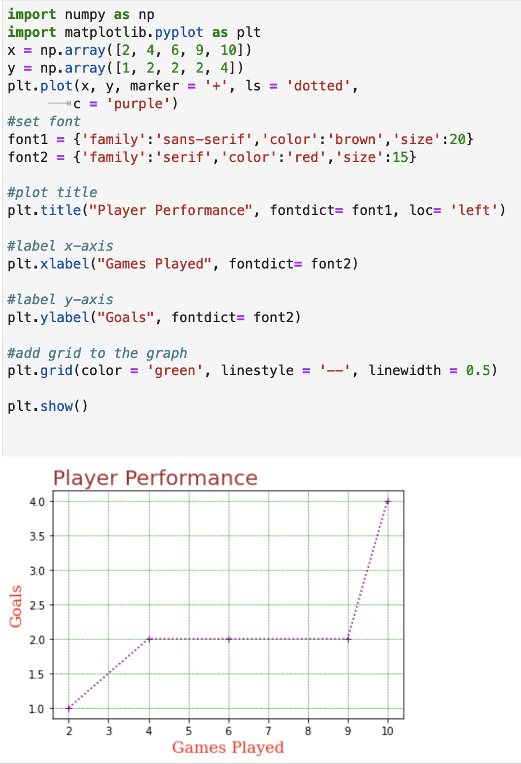
Matplotlib
Line Plot

Slide 31
Matplotlib
Subplot
Display Multiple Plot
With the subplot() function you can draw multiple plots in one figure
The subplot() function takes three arguments that describes the layout of the figure.
The layout is organized in rows and columns, which are represented by the first and second argument.
The third argument represents the index of the current plot.
Syntax:
plt.subplot(1, 2, 1)
#the figure has 1 row, 2 columns, and this plot is the first plot.
plt.subplot(1, 2, 2)
#the figure has 1 row, 2 columns, and this plot is the second plot.

Slide 32
Matplotlib
Subplot
Example:
import matplotlib.pyplot as plt
import numpy as np
#plot 1:
x = np.array([0, 1, 2, 3])
y = np.array([3, 8, 1, 10])
#the figure has 1 row, 3 columns,
#and this plot is the first plot.
plt.subplot(1, 3, 1)
plt.plot(x,y)
plt.grid()
#plot 2:
x = np.array([0, 1, 2, 3])
y = np.array([10, 20, 20, 40])
#the figure has 1 row, 3 columns, and this plot is the third #plot.
plt.subplot(1, 3, 3)
plt.plot(x,y)
plt.show()

Slide 33
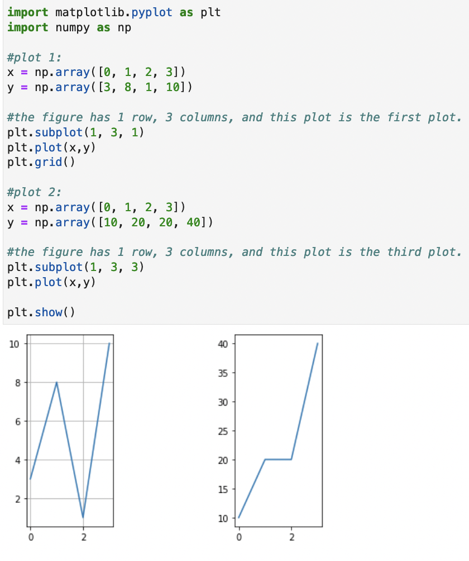
Matplotlib
Subplot

Slide 34
Matplotlib
Subplot
Example: Display multiple plot in one figure
Add a title to the entire figure with the suptitle() function:

Slide 35
Matplotlib
Subplot
x = np.array([0, 1, 2, 3])
y = np.array([10, 20, 30, 40])
plt.subplot(2, 3, 4)
plt.plot(x,y)
plt.title("April")
x = np.array([0, 1, 2, 3])
y = np.array([3, 8, 1, 10])
plt.subplot(2, 3, 5)
plt.plot(x,y)
plt.title("May")
x = np.array([0, 1, 2, 3])
y = np.array([10, 20, 30, 40])
plt.subplot(2, 3, 6)
plt.plot(x,y)
plt.title("Jun")
plt.suptitle("Total Sales")
plt.show()
import matplotlib.pyplot as plt
import numpy as np
x = np.array([0, 1, 2, 3])
y = np.array([3, 8, 1, 10])
plt.subplot(2, 3, 1)
plt.plot(x,y)
plt.title("January")
x = np.array([0, 1, 2, 3])
y = np.array([10, 20, 30, 40])
plt.subplot(2, 3, 2)
plt.plot(x,y)
plt.title("February")
x = np.array([0, 1, 2, 3])
y = np.array([3, 8, 1, 10])
plt.subplot(2, 3, 3)
plt.plot(x,y)
plt.title("March")

Slide 36
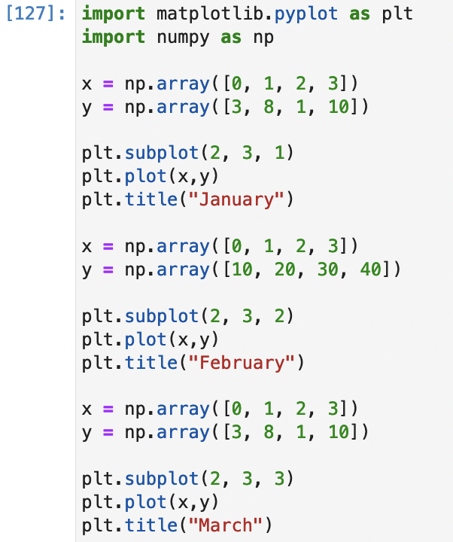
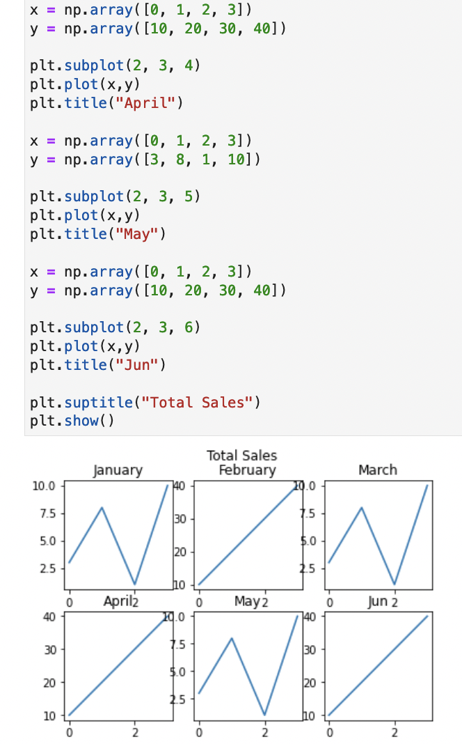
Matplotlib
Subplot

Slide 37
Matplotlib
Scatter Plot
Creating Scatter Plots
With Pyplot, use the scatter() function to draw a scatter plot.
The scatter() function plots one dot for each observation. It needs two arrays of the same length, one for the values of the x-axis, and one for values on the y-axis
Example:
import matplotlib.pyplot as plt
import numpy as np
x = np.array([5,7,8,7,2,17,2,9,4,11,12,9,6])
y = np.array([99,86,87,88,100,86,95,87,94,78,77,85,86])
#scatter plot
plt.scatter(x, y)
plt.show()

Slide 38
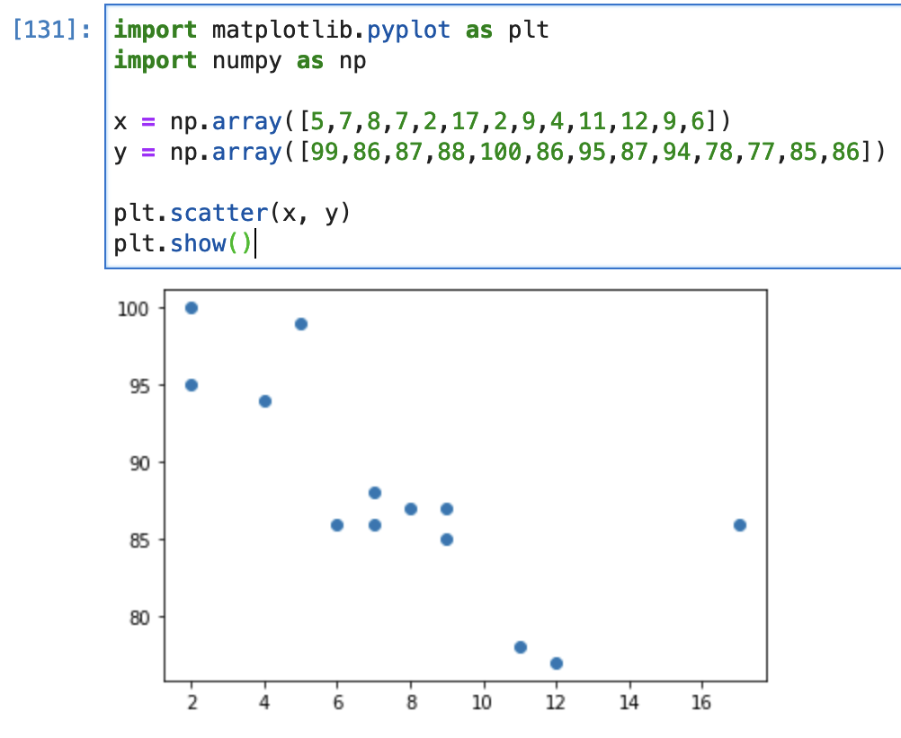
Matplotlib
Scatter Plot

Slide 39
Matplotlib
Scatter Plot
Compare Plots
Draw two plots on the same figure
Example:
import matplotlib.pyplot as plt
girls_grades = [89, 90, 70, 89, 100, 80, 90, 100, 80, 34]
boys_grades = [30, 29, 49, 48, 100, 48, 38, 45, 20, 30]
#Compare 2 plot
# Scatter plot for boys' grades with red color
plt.scatter(boys_grades, range(len(boys_grades)), color='r', label='Boys')
# Scatter plot for girls' grades with blue color
plt.scatter(girls_grades, range(len(girls_grades)), color='b', label='Girls’)
plt.xlabel('Grades Range')
plt.ylabel('Grades Scored')
plt.title('scatter plot')
plt.legend()
plt.show()

Slide 40
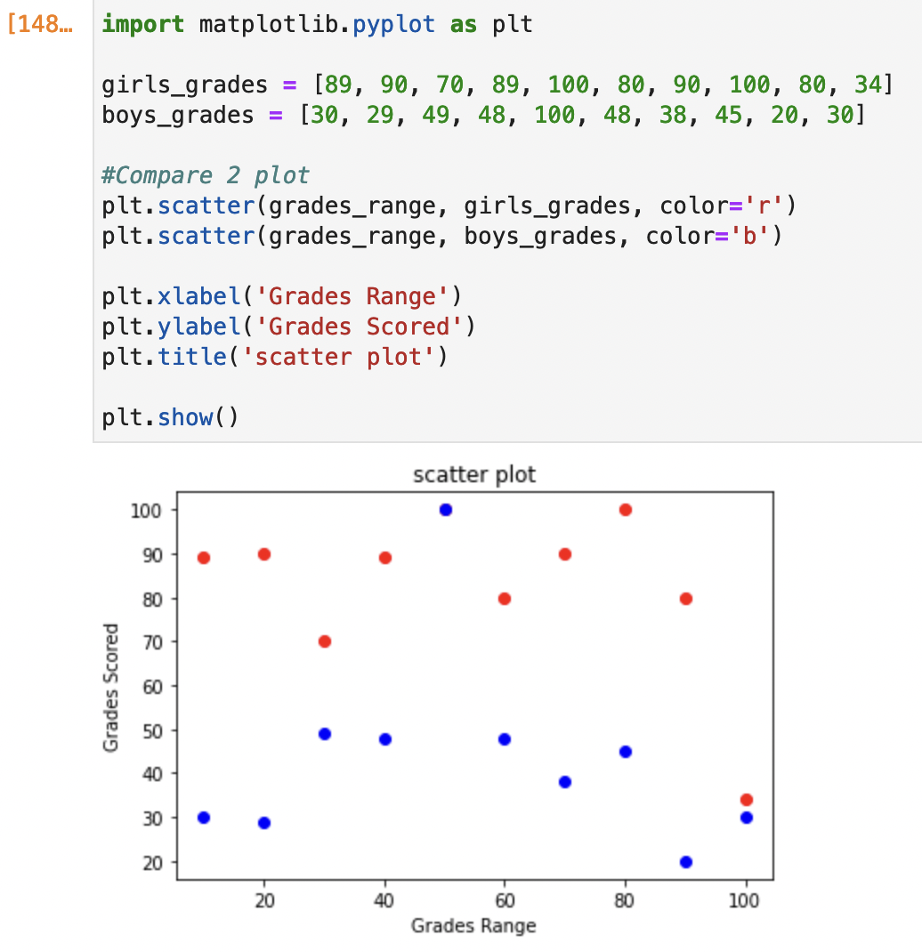
Matplotlib
Scatter Plot

Slide 41
Matplotlib
Bar Plot
A bar chart or bar graph is a chart or graph that presents categorical data with rectangular bars with heights or lengths proportional to the values that they represent.
The bars can be plotted vertically or horizontally.
With Pyplot, you can use the bar() function to draw bar graphs
Example:
import matplotlib.pyplot as plt
import numpy as np
x = np.array(["Type A", "Type B", "Type C", "Type D", "Type E"])
y = np.array([3, 8, 1, 10, 7])
#plot Bar graph
plt.bar(x,y)
plt.show()

Slide 42
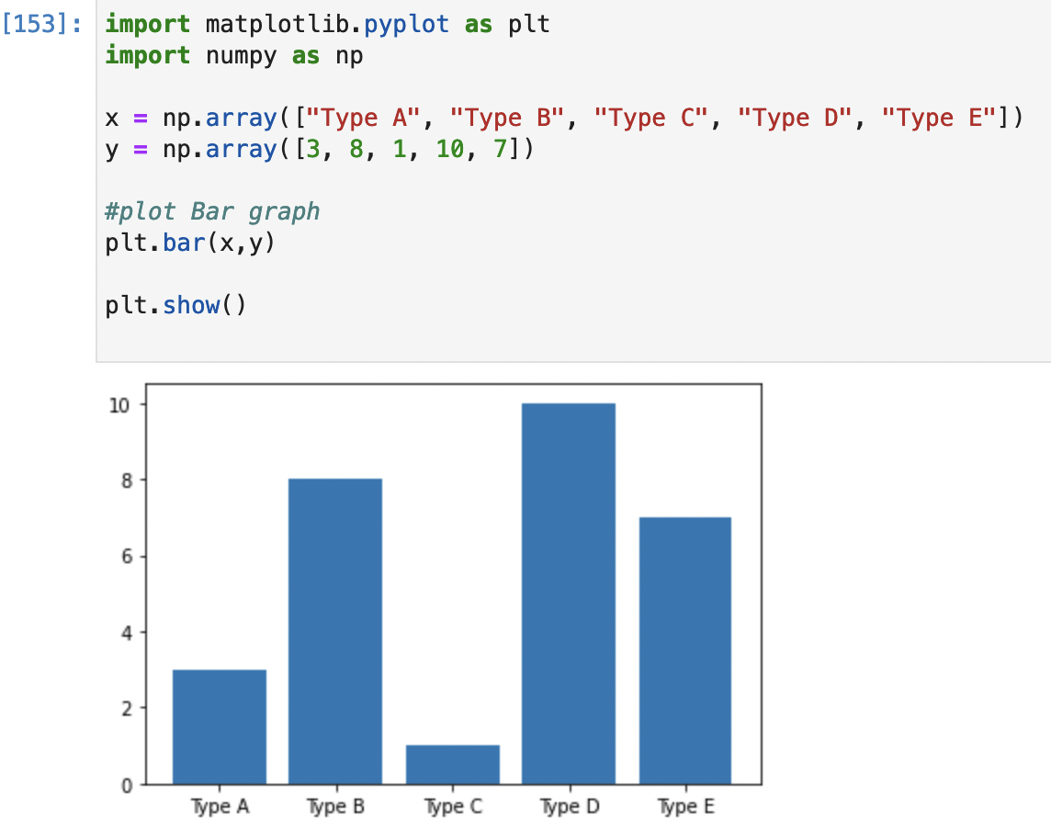
Matplotlib
Bar Plot

Slide 43
Matplotlib
Bar Plot
Bar Width
The bar() takes the keyword argument width to set the width of the bars:
The default width value is 0.8
Example:
#plot Bar graph
plt.bar(x,y, width = 0.1)

Slide 44
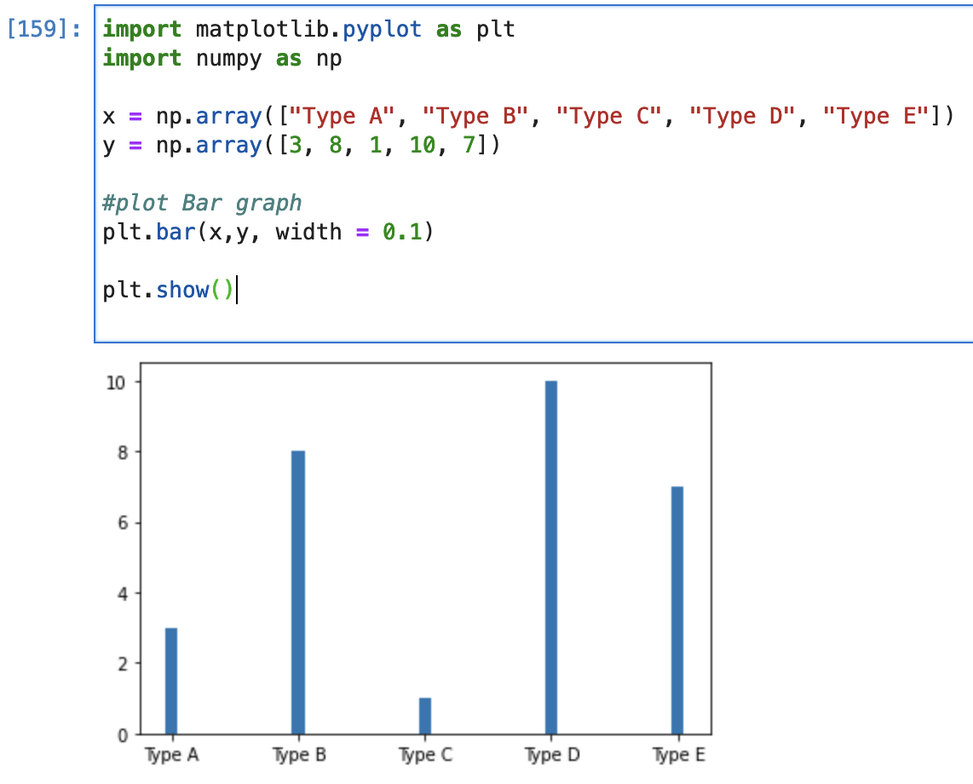
Matplotlib
Bar Plot

Slide 45
Matplotlib
Bar Plot
Horizontal Bar
If you want the bars to be displayed horizontally instead of vertically, use the barh() function
Example:
import matplotlib.pyplot as plt
import numpy as np
#draw 5 horizontal bar
x = np.array(["Type A", "Type B", "Type C", "Type D", "Type E"])
y = np.array([3, 8, 1, 10, 7])
#plot horizontal bar
plt.barh(x, y)
plt.show()

Slide 46
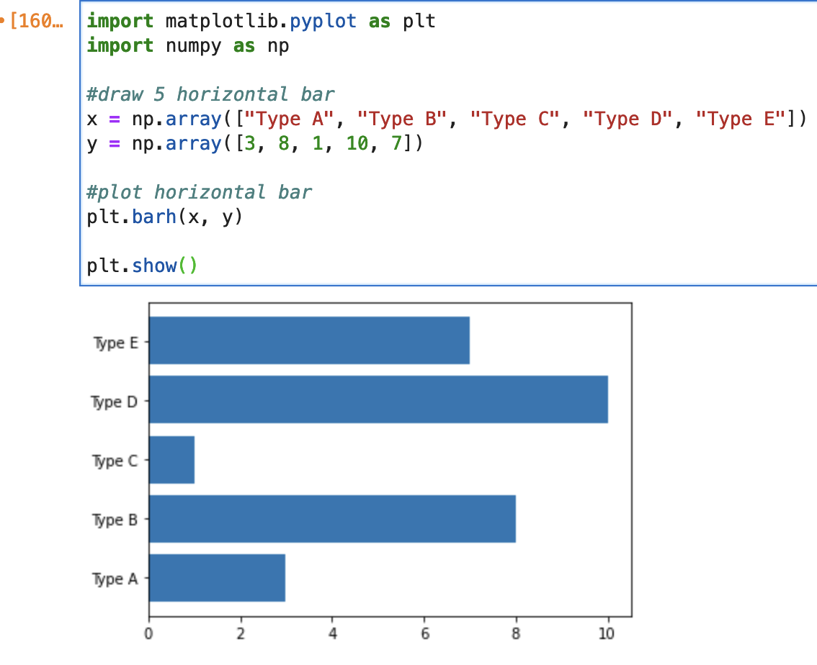
Matplotlib
Bar Plot

Slide 47
Matplotlib
Bar Plot
Bar Height
The barh() takes the keyword argument height to set the height of the bars:
The default height value is 0.8
Example:
#plot horizontal bar graph with different height
plt.barh(x,y, height = 0.3)

Slide 48
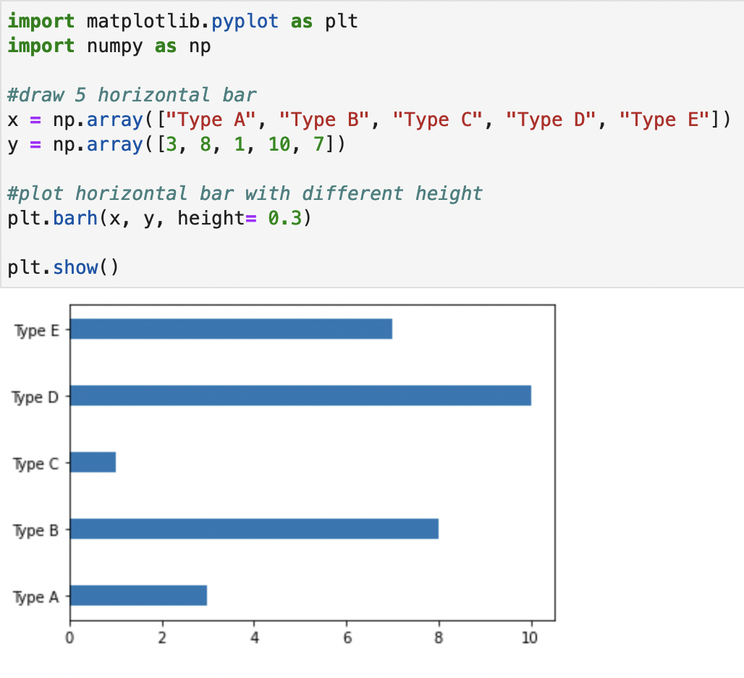
Matplotlib
Bar Plot

Slide 49
Matplotlib
Histogram
A histogram is a graph showing frequency distributions.
It is a graph showing the number of observations within each given interval.
A histogram is an accurate representation of the distribution of numerical data.
It is an estimate of the probability distribution of a continuous variable
use the hist() function to create histograms.
The hist() function will use an array of numbers to create a histogram, the array is sent into the function as an argument.

Slide 50
Matplotlib
Histogram
Example:
import matplotlib.pyplot as plt
import numpy as np
#generate random numbers
random_numbers = np.random.normal(size=10000)
#plot histogram
plt.hist(random_numbers)
plt.title("Gaussian Histogram")
plt.xlabel("Value")
plt.ylabel("Frequency")
plt.show()

Slide 51
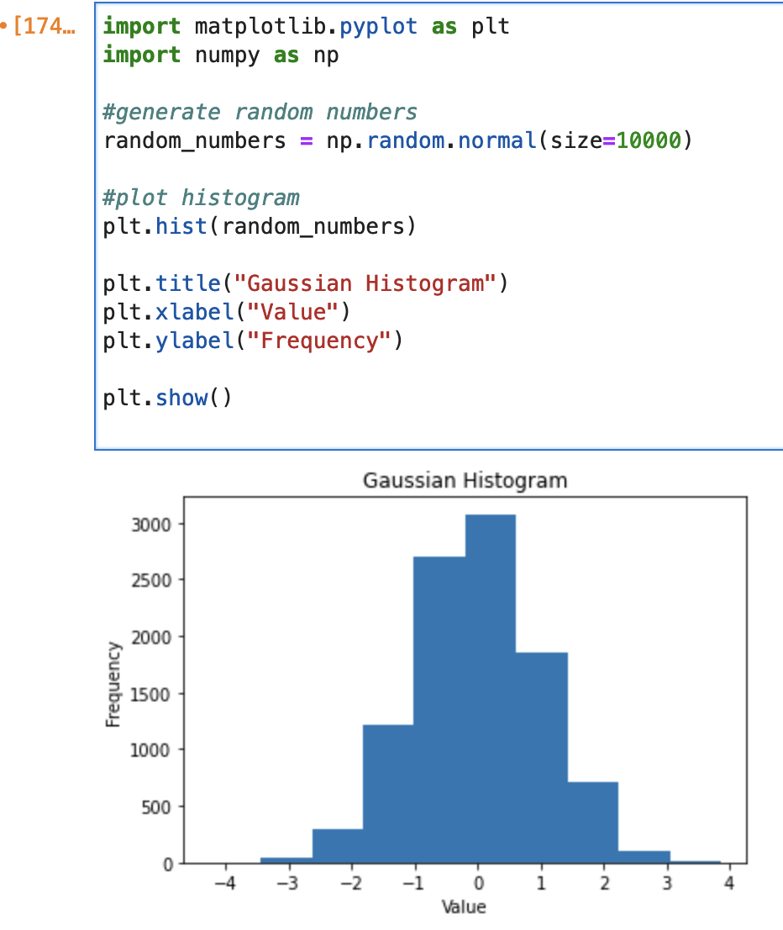
Matplotlib
Histogram
Example:

Slide 52
Matplotlib
Pie Chart
Create Pie Chart
A Pie Chart is a circular statistical plot that can display only one series of data.
The area of the chart is the total percentage of the given data.
The area of slices of the pie represents the percentage of the parts of the data.
The slices of pie are called wedges.
With Pyplot, use the pie() function to draw pie charts

Slide 53
Matplotlib
Pie Chart
Example:
# Import libraries
from matplotlib import pyplot as plt
import numpy as np
# Creating dataset
cars = ['AUDI', 'BMW', 'FORD',
'TESLA', 'JAGUAR', 'MERCEDES']
data = [23, 17, 35, 29, 12, 41]
# Creating plot
fig = plt.figure(figsize =(10, 8))
plt.pie(data, labels = cars)
# show plot
plt.show()

Slide 54
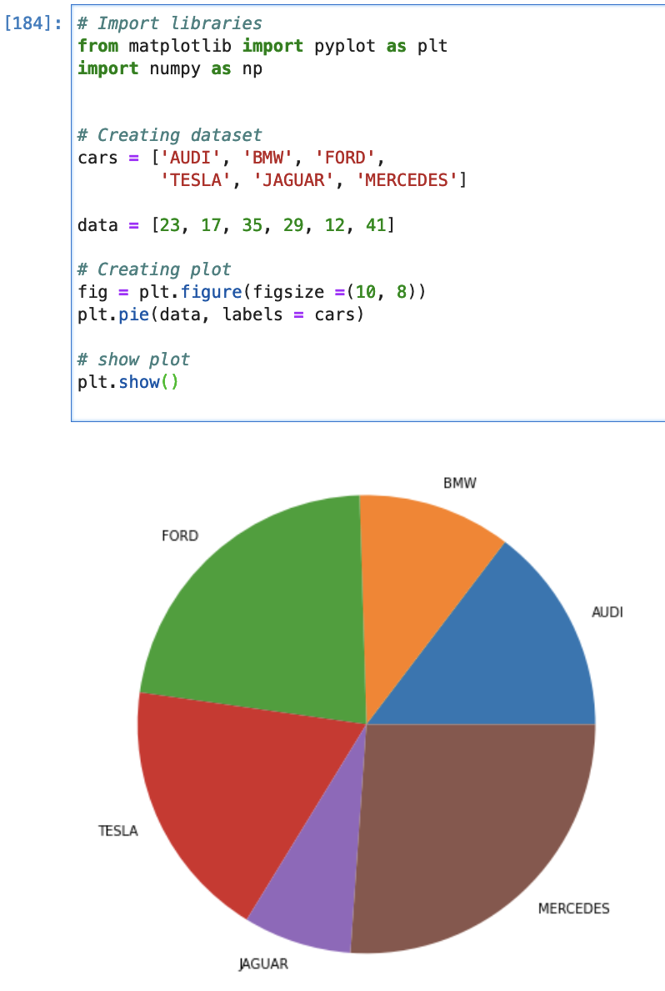
Matplotlib
Pie Chart

Slide 55
Matplotlib
Plotting Data from A File
Plotting data from a file is a two-step process.
Interpreting the file and loading the data.
Creating the actual plot.
The recommended way of plotting data from a file is to use dedicated functions such as numpy.loadtxt or pandas.read_csv to read the data.
These are more powerful and faster.
Then plot the obtained data using matplotlib.

Slide 56
Matplotlib
Plotting Data from A File
Example:
Download dataset from Github
Import the necessary libraries and check out the dataset:
import pandas as pd
import matplotlib.pyplot as plt
df = pd.read_csv('WorldHappiness2018_Data.csv')
df.head()

Slide 57
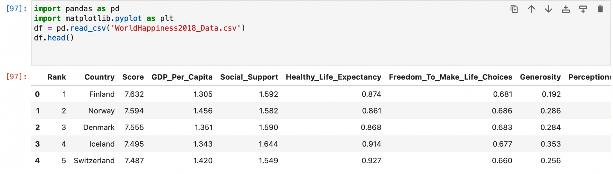
Matplotlib
Plotting Data from A File

Slide 58
Matplotlib
Plotting Data from A File
Line Graph
Line graphs are the simplest graph one can create using Matplotlib. Let’s create a graph to see the relationship between a country’s rank and their happiness score.
rank = df[‘Overall rank']
score = df['Score']
These two lines of code subset the dataframe.
The first creates a Series that only contains the overall rank for each country.
The second creates a Series that only contains the happiness score for each country.

Slide 59
Matplotlib
Plotting Data from A File
Line Graph
These next two lines of code create the actual plot:
plt.plot(rank, score)
plt.show()
The plt.plot() command creates a line graph, and the parameters passed in tell the function what data to use.
The first, rank, will be plotted on the x-axis, and the second, score, will be plotted on the y-axis.
Calling plt.show() is required for your graph to actually be printed onto your screen.

Slide 60
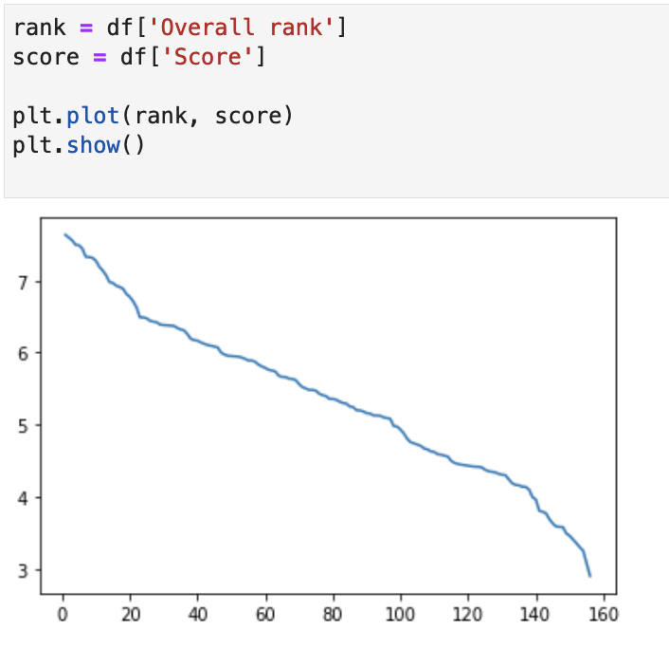
Matplotlib
Plotting Data from A File
Line Graph
Output:

Slide 61
Matplotlib
Plotting Data from A File
Line Graph
Full code:
#import libraries
import pandas as pd
import matplotlib.pyplot as plt
df = pd.read_csv('WorldHappiness2018_Data.csv')
#set parameter
rank = df[‘Overall rank']
score = df['Score']
#plot parameter
plt.plot(rank, score)
plt.show()

Slide 62
Matplotlib
Plotting Data from A File
Filter Data From A File
FIlter data to put into the pandas dataframe by using nrows.
To only read the first few rows, pass the number of rows to read to the nrows parameter.
By default, the read_csv() function reads the entire CSV file as a dataframe.
The following is the syntax: df = pd.read_csv(FILE_PATH, nrows=n)

Slide 63
Matplotlib
Plotting Data from A File
#parameter
rank = df[‘Overall rank']
score = df['Score']
#plot parameter
plt.plot(rank, score)
plt.title('Happiness Score vs World Rank')
plt.xlabel('Country Rank')
plt.ylabel('Country Score')
plt.show()
Example:
#import libraries
import pandas as pd
import matplotlib.pyplot as plt
#read csv file
df = pd.read_csv('WorldHappiness2018_Data.csv', nrows=20)

Slide 64
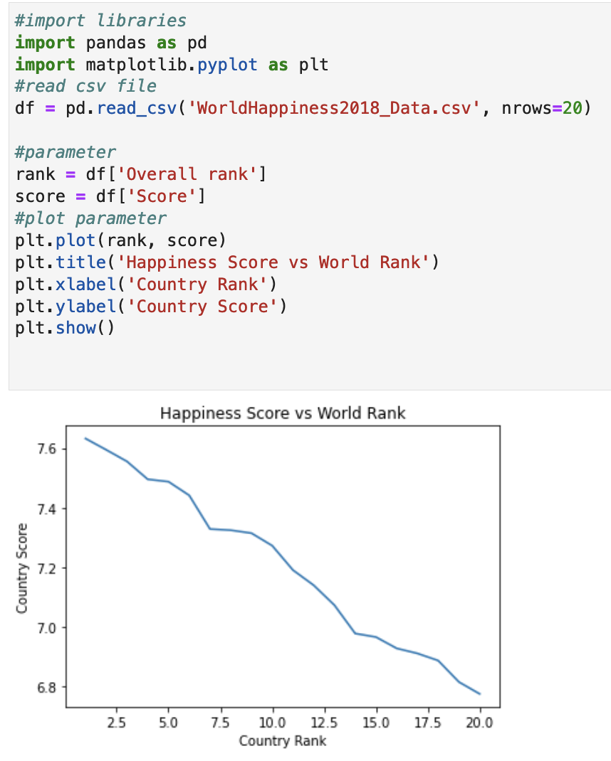
Matplotlib
Plotting Data from A File
Output

Slide 65
Matplotlib
Plotting Data from A File
Add More Variable To The Graph
Call plt.plot() twice with the two different series that you’d like to pass as the parameters for the x-value
Example:
#parameter 1
gdp = df['GDP per capita']
#parameter 2
lifeExp = df['Healthy life expectancy']
#plot parameter 1
plt.plot(rank, gdp)
#plot parameter 2
plt.plot(rank, lifeExp)
plt.show()

Slide 66
Matplotlib
Plotting Data from A File
Full code:
import pandas as pd
import matplotlib.pyplot as plt
df = pd.read_csv('WorldHappiness2018_Data.csv')
#parameter 1
gdp = df['GDP_Per_Capita']
#parameter 2
lifeExp = df['Healthy_Life_Expectancy']
#plot parameter 1
plt.plot(rank, gdp)
#plot parameter 2
plt.plot(rank, lifeExp)
plt.show()

Slide 67
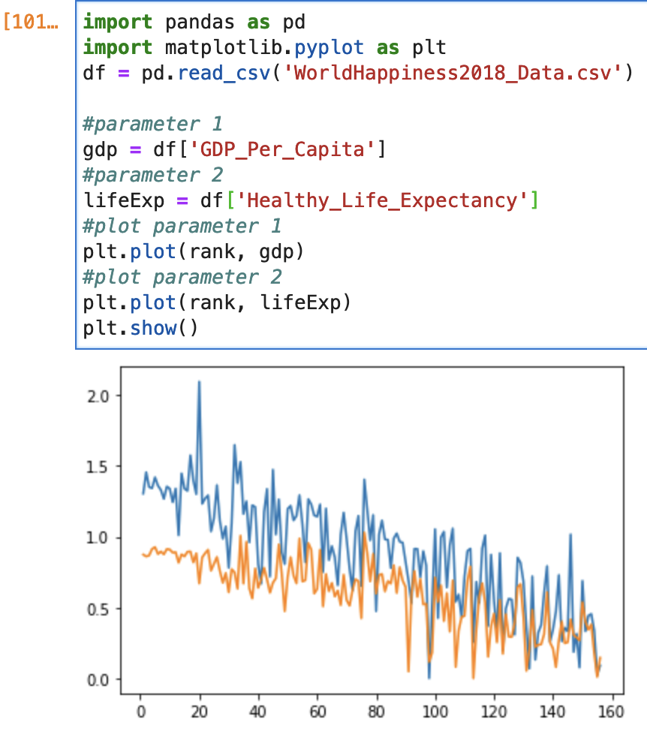
Matplotlib
Plotting Data from A File
Add More Than One Variable To The Graph
Output:

Slide 68
Matplotlib
Plotting Data from A File
Add Legend To The Graph
Add a legend to tell us what color line represents which variable.
Example:
#set parameters
rank = df['Overall rank']
score = df['Score']
gdp = df['GDP per capita']
lifeExp = df['Healthy life expectancy']
# Option 1
plt.plot(rank, gdp, label = 'GDP Per Capita')
plt.plot(rank, lifeExp, label = 'Healthy Life Expectancy')
plt.title('World Rank vs GDP and Life Expectancy')
plt.xlabel('Country Rank')
plt.ylabel('Country Score')
plt.legend()
plt.show()

Slide 69
Matplotlib
Plotting Data from A File
# Option 2
plt.plot(rank, gdp, color = 'green', label = 'GDP_Per_Capita')
plt.plot(rank, lifeExp, color = 'blue', label = 'Healthy_Life_Expectancy')
plt.title('World Rank vs GDP and Life Expectancy')
plt.xlabel('Country Rank')
plt.ylabel('Country Score')
plt.legend()
plt.show()

Slide 70
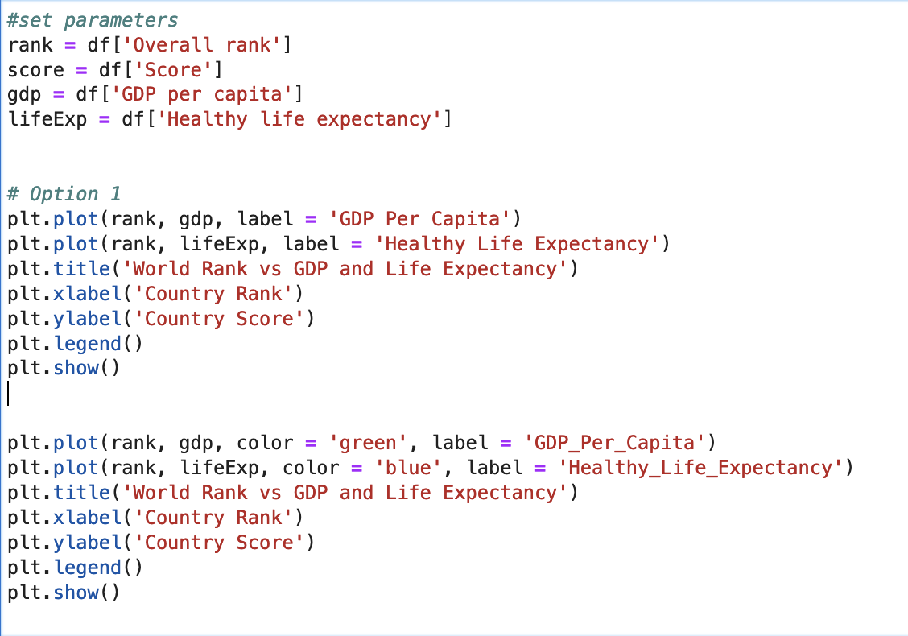
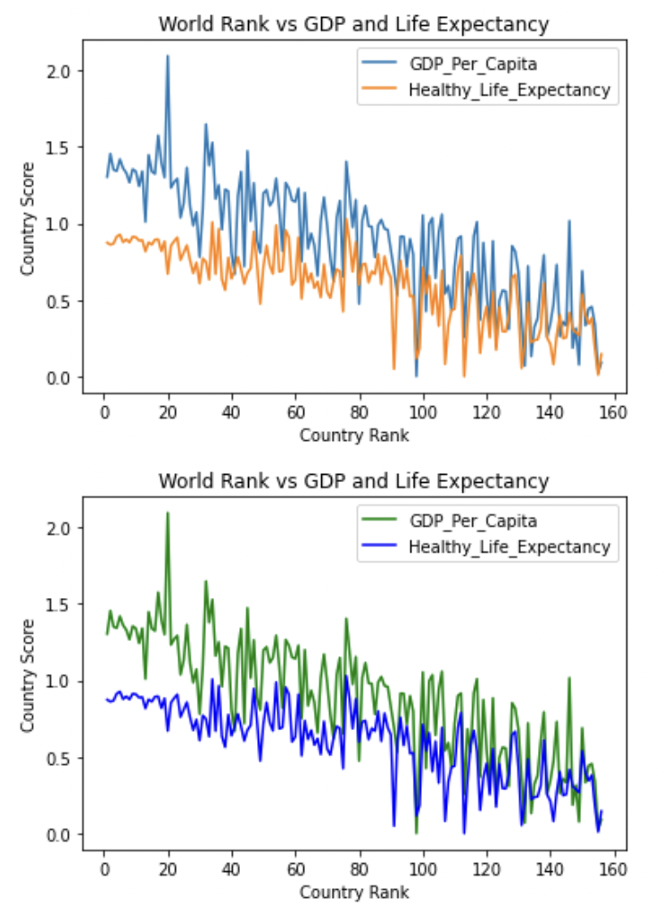
Matplotlib
Plotting Data from A File
Add Legend To The Graph
Output:

Slide 71
Matplotlib
Plotting Data from A File
Scatter Plot
Scatterplots are a great way to visualize a relationship between two variables without the potential for a crazy trend line that we might get from a line graph.
Example:
#import libraries
import pandas as pd
import matplotlib.pyplot as plt
df = pd.read_csv('WorldHappiness2018_Data.csv')
#set parameters
rank = df['Overall rank']
score = df['Score']
gdp = df['GDP per capita']
lifeExp = df['Healthy life expectancy']
#scatter plot
plt.scatter(gdp, score)
plt.title('GDP vs Happiness Score')
plt.xlabel('GDP per Capita')
plt.ylabel('Happiness Score')
plt.ylim(0, 8)
plt.show()

Slide 72
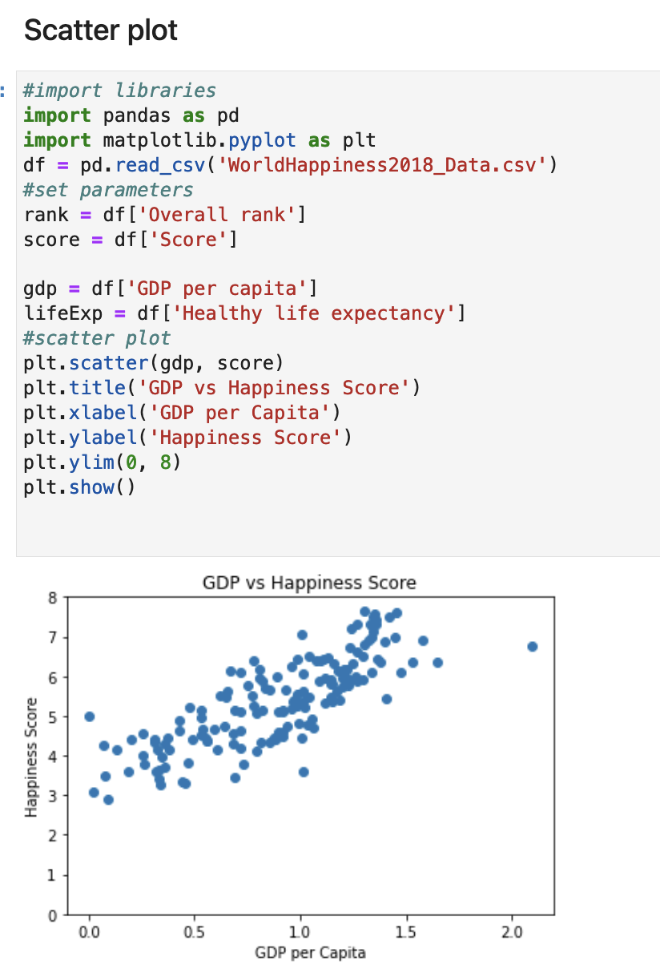
Matplotlib
Plotting Data from A File
Scatter Plot
Output:

Slide 73
Matplotlib
Plotting Data from A File
Histograms
A histogram shows the distribution of a particular feature of the data.
It can shows us how many observations take a certain value.
Example:
#import libraries
import pandas as pd
import matplotlib.pyplot as plt
df = pd.read_csv('WorldHappiness2018_Data.csv')
#set parameters
rank = df['Overall rank']
score = df['Score']
gdp = df['GDP per capita']
lifeExp = df['Healthy life expectancy']
#histogram plot
plt.hist(score)
plt.title('Happiness Score Distribution')
plt.xlabel('Happiness Score')
plt.ylabel('Frequency')
plt.show()

Slide 74
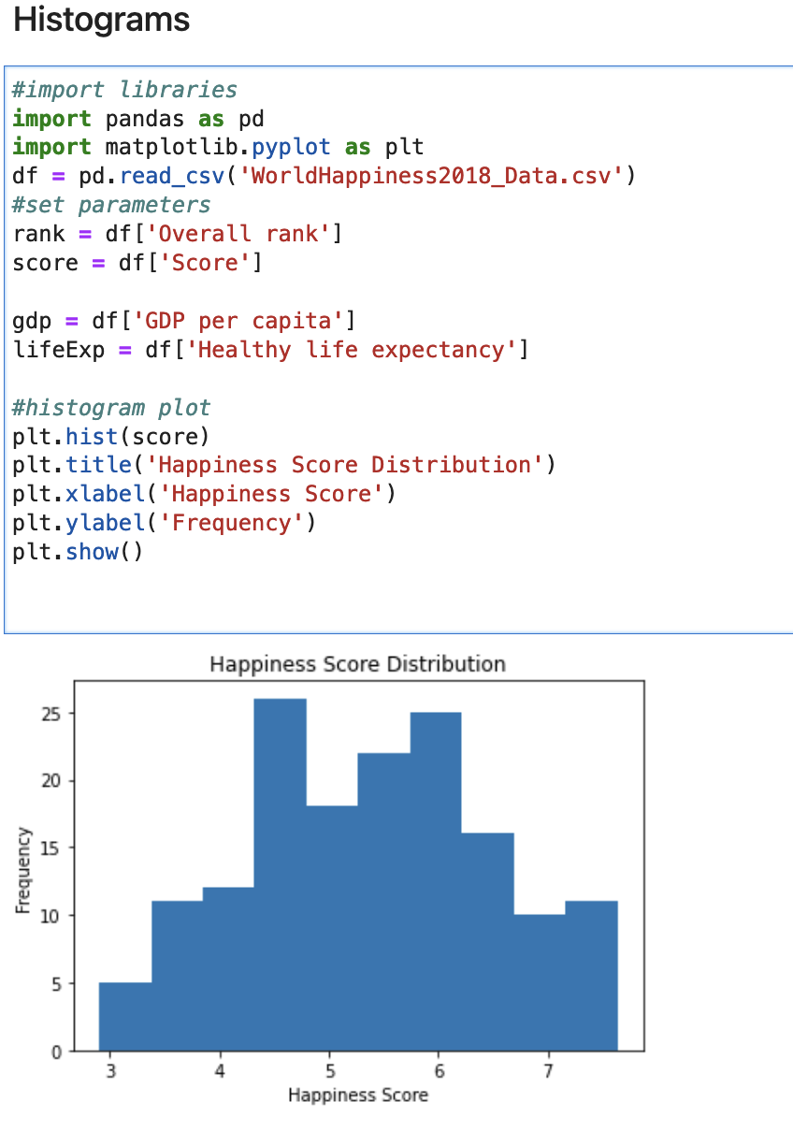
Matplotlib
Plotting Data from A File
Histogram
Output:

Slide 75
Matplotlib
Plotting Data from A File
Bar Graph
A few parameters needed to be set before plotting the data using Bar graph
Example:
roundedHappinessScore = score.apply(int)
count = roundedHappinessScore.value_counts()
hapScore = count.index
The first line converts all of the happiness scores to an integer, that way there are only a few discrete values that the happiness score can take.
The second line gets the number of times each score occurs. This count will be used as the height for our bar graph.
The third line, gets the score associated with each count, which is needed as the x-axis of our graph.

Slide 76
Matplotlib
Plotting Data from A File
Bar Graph
Full Code:
#import libraries
import pandas as pd
import matplotlib.pyplot as plt
df = pd.read_csv('WorldHappiness2018_Data.csv')
#set parameters
rank = df['Overall rank']
score = df['Score']
gdp = df['GDP per capita']
lifeExp = df['Healthy life expectancy']
roundedHappinessScore = score.apply(int)
count = roundedHappinessScore.value_counts()
hapScore = count.index
plt.bar(hapScore, count)
plt.title('Happiness Scores’)
plt.xlabel('Score')
plt.ylabel('Count')
plt.show()

Slide 77
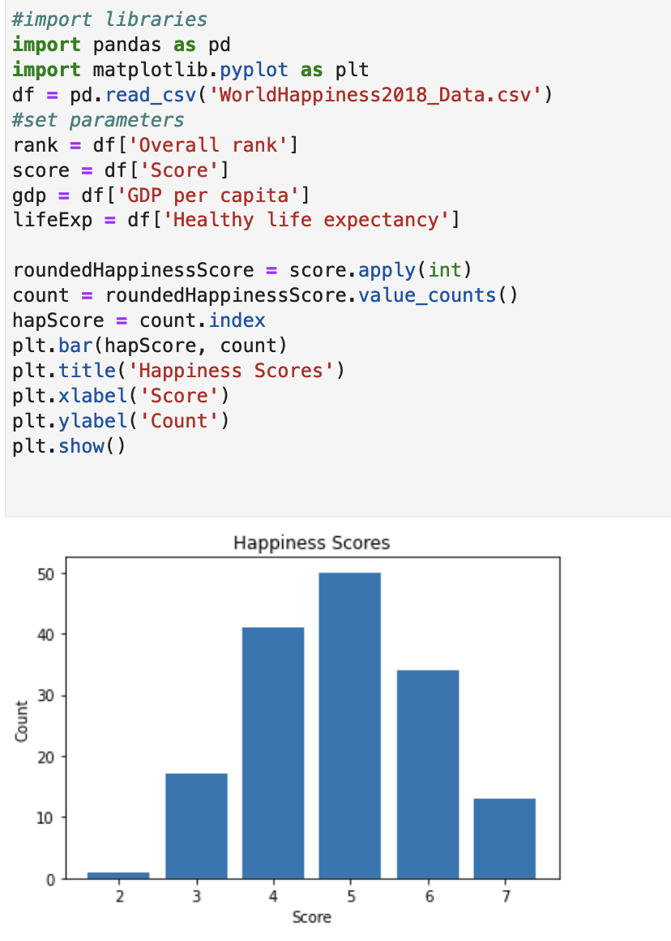
Matplotlib
Plotting Data from A File
Output:

Slide 78

Seaborn
Introduction
Seaborn is a Python data visualization library based on matplotlib.
Provides a high-level interface for drawing attractive and informative statistical graphics.

Slide 79
Seaborn
Introduction
Functionalities:
Allows for comparison between multiple variables.
Supports multi-plot grids
Availability of different colour palettes

Slide 80
Seaborn
Advantages of Seaborn
Easily represent our data on a plot.
Creates an interactive and informative plot to representation our data; easy for the user to understand and visualize the records on the application.
Statistically-Minded Plots: Has some built-in plots that are not available in matplotlib
Automatic estimation and plotting of linear regression plots.

Slide 81
Seaborn
Module Installation
Install seaborn using pip:
$ pip install seaborn

Slide 82
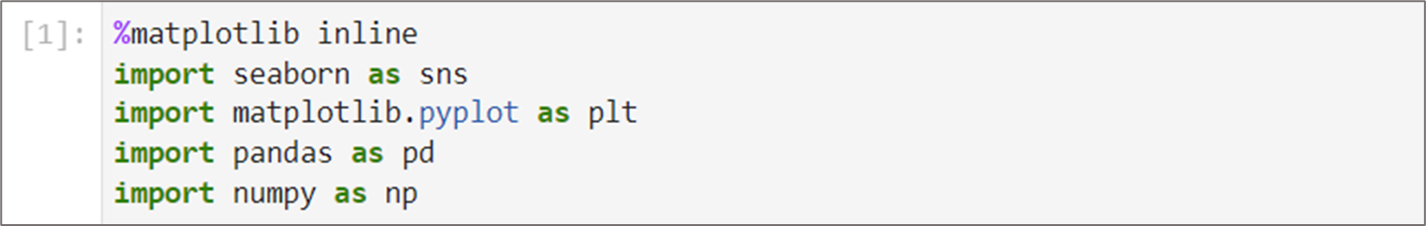
Seaborn
Import & Load Dataset
Import all the libraries as below:
$ %matplotlib inline
$ import seaborn as sns
$ import matplotlib.pyplot as plt
$ import pandas as pd
$ import numpy as np

Slide 83
Seaborn
Import & Load Dataset
Ignore warning related to figure layout:
import warnings
def fxn():
warnings.warn("deprecated", DeprecationWarning)
with warnings.catch_warnings():
warnings.simplefilter("ignore")
fxn()
# Suppress UserWarning from seaborn
warnings.filterwarnings("ignore", message="The figure layout has changed to tight", category=UserWarning)

Slide 84
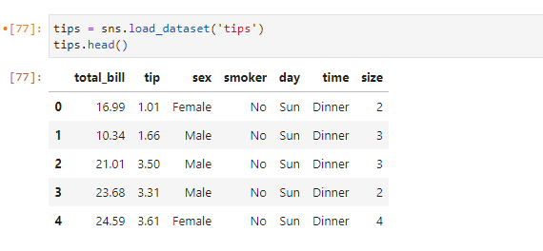
Seaborn
Import & Load Dataset
Seaborn allows us to load dataset that are available in Github : https://github.com/mwaskom/seaborn-data
$ tips = sns.load_dataset(“tips”)
$ tips.head()

Slide 85
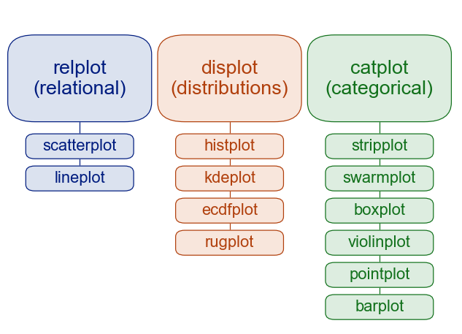
Seaborn
Plotting Function
Visualizing Statistical Relationships
Process of understanding relationships between variables of a dataset.
Plotting with Categorical Data
Main variable is further divided into discrete groups.
Visualizing the distribution of a dataset
Understanding datasets with context to being univariate or bivariate.
Notes:
Univariate = analysis of a single variable or data set at a time.
Bivariate = analysis of two variables or data sets simultaneously to find relationships or patterns between them.

Slide 86
Seaborn
Visualizing Statistical Relationships
Scatter plot
One of the suitable visualization to see the relationship between variables.
Basic parameters available in relplot() :
x : column for x-axis data
y : column for y-axis data
data : data source for visualization
Example :
$ sns.relplot(x=‘total_bill', y=‘tip', data=tips)

Slide 87
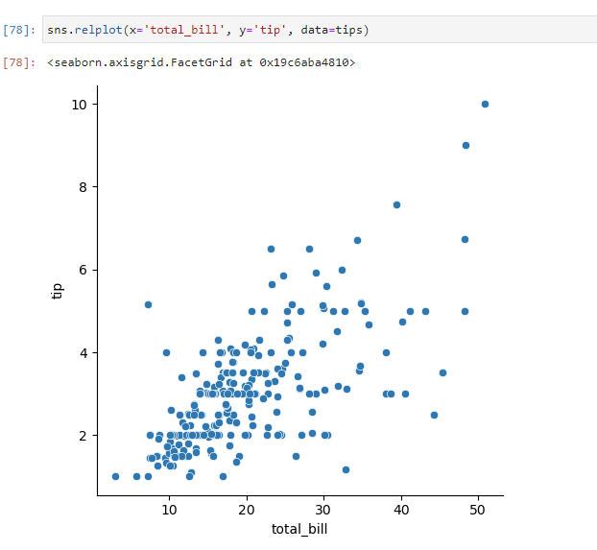
Seaborn
Visualizing Statistical Relationships

Slide 88
Seaborn
Visualizing Statistical Relationships
Scatter plot
Adding more parameters to see more details.
Additional parameter :
hue : this parameter take column name for colour encoding.
$ sns.relplot(x='total_bill', y='tip', hue='smoker', data=tips)

Slide 89
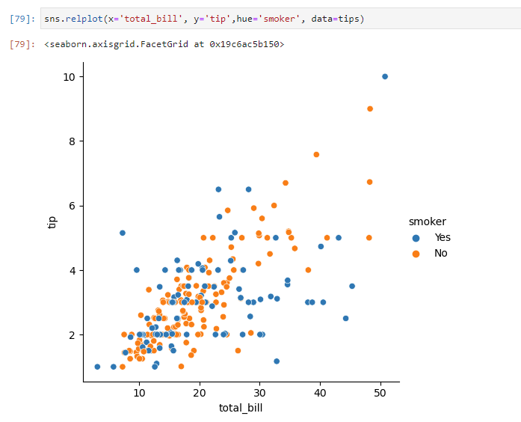
Seaborn
Visualizing Statistical Relationships

Slide 90
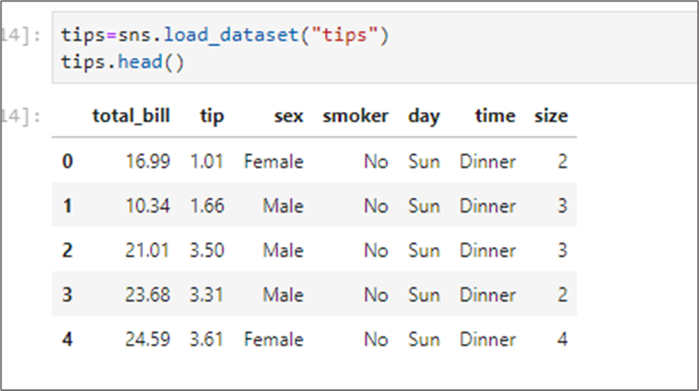
Seaborn
Visualizing Statistical Relationships
Line plot
Good visualization to see relationship between variables.
$ tips=sns.load_dataset("tips")
$ tips.head()

Slide 91
Seaborn
Visualizing Statistical Relationships
Line plot
Additional parameter used :
kind : parameter to specify which plot to use.
eg :
$ sns.relplot(x='day', y='tip',kind='line',data=tips)
From the code above, kind=’line’ means we want to visualize data using line plot.
By default, the ”kind” for relplot is scatter plot.

Slide 92
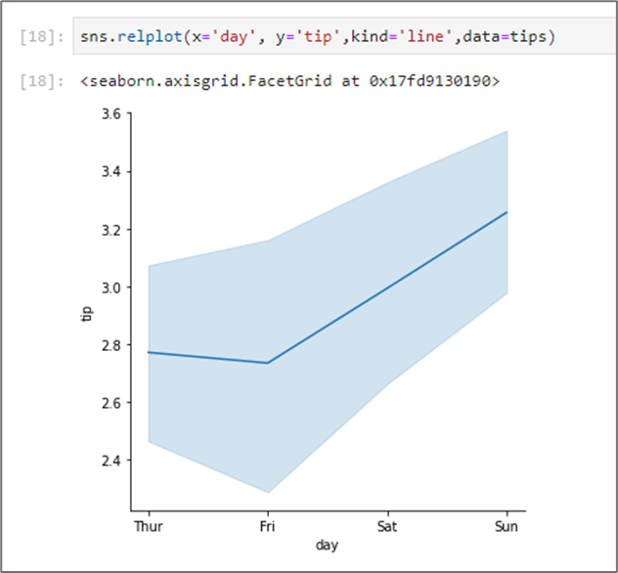
Seaborn
Visualizing Statistical Relationships

Slide 93
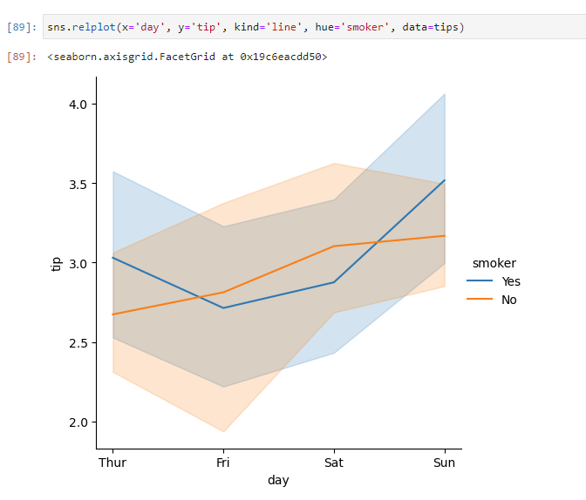
Seaborn
Visualizing Statistical Relationships
The "hue" parameter can also be used in line plot.
For example:
sns.relplot(x='day', y='tip', kind='line', hue='smoker', data=tips)

Slide 94
Seaborn
Visualizing Statistical Relationships
Exercise
Using the dataset "taxis", create a scatter plot based on the passengers & total fare
Based on question 1, find the borough with the most expensive total fare for a six passengers trip.
Using the dataset "flights", create a line plot showing relationship between 'passengers' & 'year'.
Based on question 3, create multiple lines within the line plot based on months.

Slide 95
Seaborn
Plotting with Categorical Data
Plotting with categorical data requires a more specialized approach when it comes to visualization.
Can be used if one of the main variables is “categorical” (divided into discrete groups).
Requires a figure-level interface that gives a unified higher-level access to them.
Uses catplot() for categorical plots.

Slide 96
Seaborn
Plotting with Categorical Data
Scatter plot
Basic parameters available in catplot :
x : column for x-axis data
y : column for y-axis data
data : data source for visualization
$ sns.catplot(x='day', y='total_bill',data=tips)

Slide 97
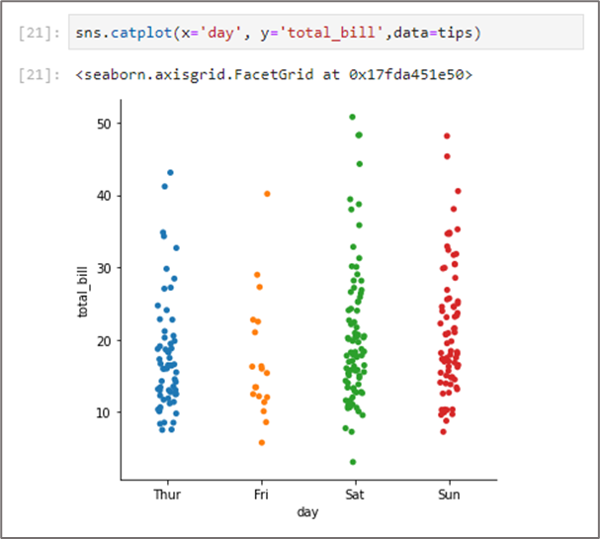
Seaborn
Plotting with Categorical Data

Slide 98
Seaborn
Plotting with Categorical Data
Bar plot
Additional parameter used :
kind : parameter to specify which plot to use.
By default, the ”kind” for catplot is scatter plot.
example :
$ titanic=sns.load_dataset("titanic")
$ sns.catplot(x="sex", y="survived", kind="bar", data=titanic)
From the code above, kind=’bar’ means we want to visualize data using bar plot.

Slide 99
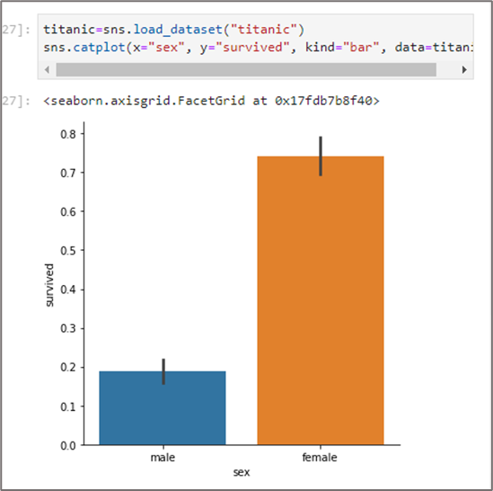
Seaborn
Plotting with Categorical Data

Slide 100
Seaborn
Plotting with Categorical Data
Bar plot
Additional parameter used :
hue : this parameter take column name for colour encoding.
kind : to specify type of plot to visualize.
$ sns.catplot(x="sex", y="survived",hue="class", kind="bar", data=titanic)

Slide 101
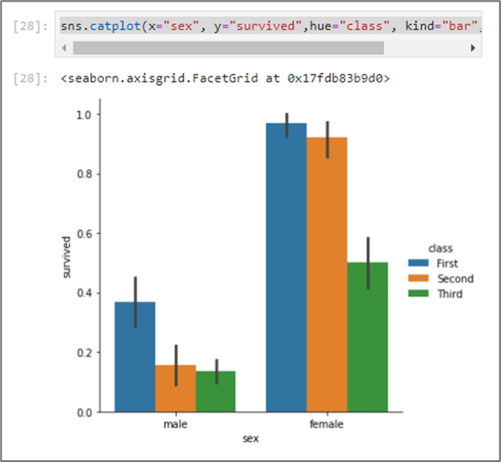
Seaborn
Plotting with Categorical Data

Slide 102
Seaborn
Plotting with Categorical Data
Show value in bar chart
# Create a bar plot
g = sns.catplot(x="sex", y="survived", kind="bar", errorbar=None, data=titanic)
# Annotate each bar with its value
for ax in g.axes.flat:
for p in ax.patches:
ax.text(p.get_x() + p.get_width() / 2., p.get_height(),
f'{p.get_height():.2f}',
ha='center', va='bottom')
# Show the plot
plt.show()

Slide 103
Seaborn
Plotting with Categorical Data
Exercise
Using the “taxis” dataset, create a scatter plot relating the “pickup_borough” with “tips”.
Based on the “titanic” dataset, create a bar plot relating to the “who” & “survived” columns.
Based on question 2, find the value of child survivors from third class.

Slide 104
Seaborn
Plotting with Categorical Data
Box plot
Boxplots encode valuable information about our distribution. From each box, the following pieces of information are shown:
The central line of each box represents the median value
The top and bottom of the boxes are the 3𝑟𝑑 and 1𝑠𝑡 quantile, respectively.
This means that 25% of all values are below the bottom line and 25% are above the top line, i.e. 50% of all values are within the colored region
The whiskers denote the outlier limits. Any value between the whiskers is considered "normal"
The points outside of the whiskers are outliers that may require special attention

Slide 105
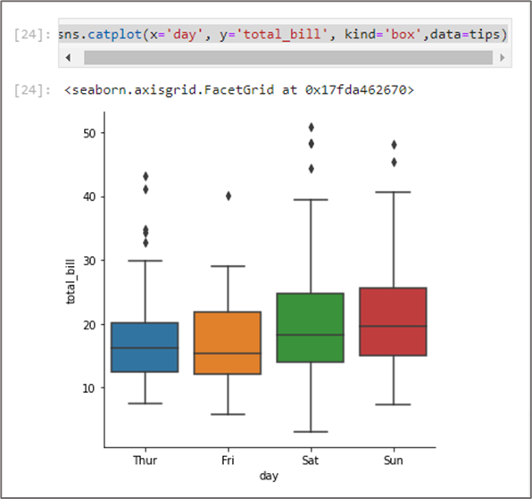
Seaborn
Plotting with Categorical Data
Box plot
$ sns.plot(x='day', y='total_bill', kind='box',data=tips)

Slide 106
Seaborn
Plotting with Categorical Data
Violin plot
The statistics summary of violin plots:
the white dot represents the median
the thick black bar in the center represents the interquartile range
the thin black line represents the rest of the distribution

Slide 107
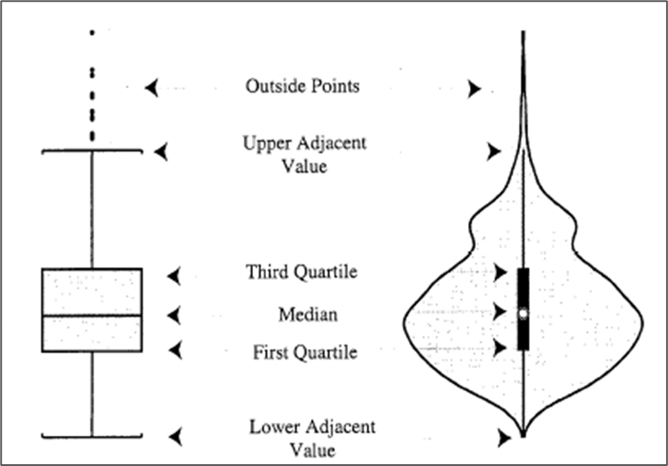

Seaborn
Plotting with Categorical Data
Differences between Box Plot versus Violin Plot

Slide 108
Seaborn
Plotting with Categorical Data
Violin plot
$ sns.catplot(x='day', y='total_bill',hue="sex",split=True, kind='violin',data=tips)
Additional parameter used:
a) hue = ‘sex’ : to visualize data by gender
b) split = ‘True’ : to visualize categorical data side by
side.

Slide 109
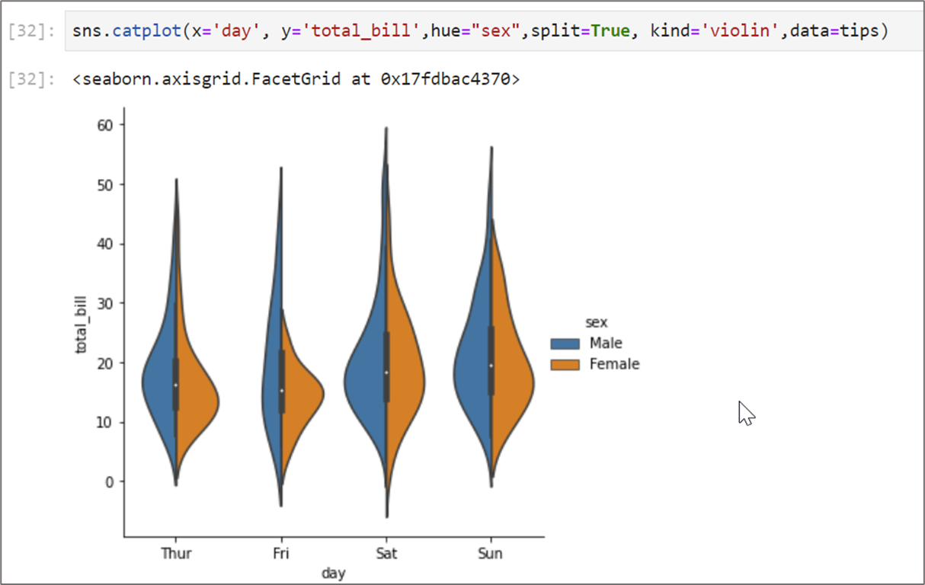
Seaborn
Plotting with Categorical Data

Slide 110
Seaborn
Visualize the distribution of dataset
Figure-level interface for drawing distribution plots.
Provides access to several approaches for visualizing the univariate or bivariate distribution of data.
By default, uses displot() for visualization.

Slide 111
Seaborn
Visualize the distribution of dataset
Plotting univariate histograms
Histograms are used as the default visualization for distribution
It is also used as the main visualization form for univariate distribution
A histogram is a bar plot where the axis representing the data variable is divided into a set of discrete bins and the count of observations falling within each bin is shown using the height of the corresponding bar.
Univariate distribution refers to a single variable while bivariate distribution refers to two separate variables.

Slide 112
Seaborn
Visualize the distribution of dataset
Plotting univariate histograms
# Import Module & Dataset
import seaborn as sns
import matplotlib.pyplot as plt
import pandas as pd
import numpy as np
penguins = sns.load_dataset("penguins")
penguins.head()
# Visualize displot
sns.displot(penguins, x="flipper_length_mm")

Slide 113
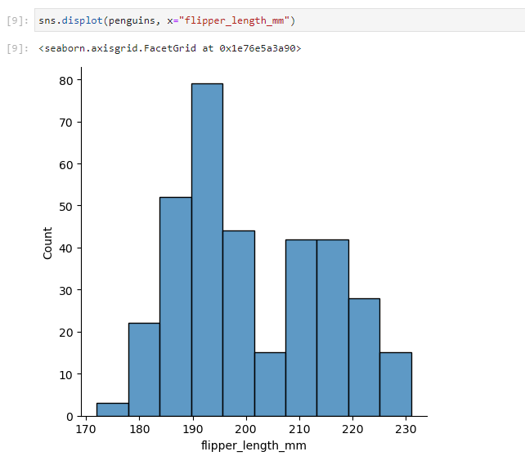
Seaborn
Visualize the distribution of dataset
The shown visualization appears to be bimodal, which does not represent the data quite well.
To create a more accurate representation, bin size is used to set the range of the variable.
Bin size is written as binwidth().

Slide 114
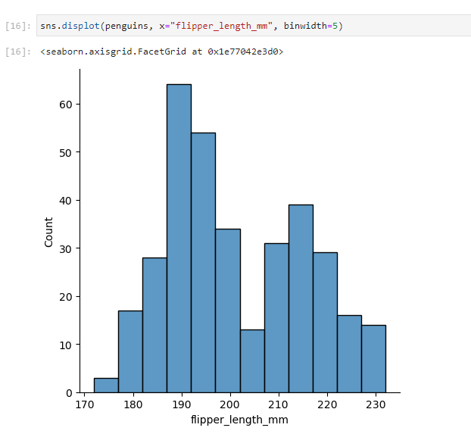
Seaborn
Visualize the distribution of dataset
# Example usage:
sns.displot(penguins, x="flipper_length_mm", binwidth=5)

Slide 115
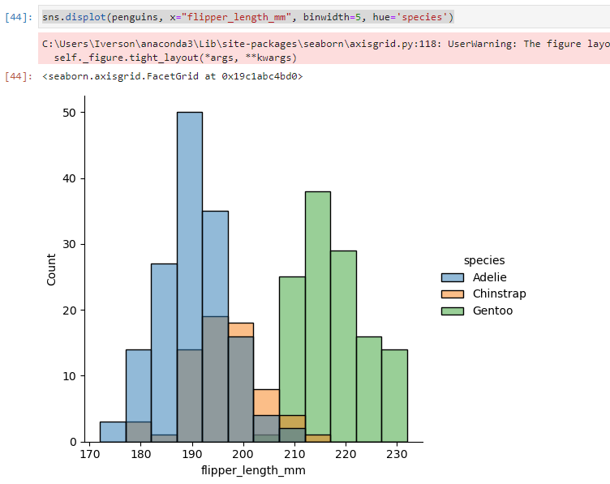
Seaborn
Visualize the distribution of dataset
Additional parameters that can be used:
Hue (based on category)
# Example usage:
sns.displot(penguins, x="flipper_length_mm", binwidth=5, hue='species')
By default, the different histograms are “layered” on top of each other and, in some cases, they may be difficult to distinguish.

Slide 116

Seaborn
Visualize the distribution of dataset
The "multiple" parameter can be used to change the visualization of the histogram.
The parameter multiple='stack' is used the stack the bars together.
The outline of the full histogram will match the plot with only a single variable.

Slide 117

Seaborn
Visualize the distribution of dataset
Another option, multiple='dodge' moves the bars horizontally and reduces their width.
Ensures that there are no overlaps and that the bars remain comparable in terms of height
The outline of the full histogram will match the plot with only a single variable.

Slide 118

Seaborn
Visualize the distribution of dataset
A bivariate histogram bins the data within rectangles that tile the plot and then shows the count of observations within each rectangle with the fill color.

Slide 119
Seaborn
Visualize the distribution of dataset
Plotting bivariate histograms
# Import Module & Dataset
import seaborn as sns
import matplotlib.pyplot as plt
import pandas as pd
import numpy as np
penguins = sns.load_dataset("penguins")
penguins.head()
# Visualize displot
sns.displot(penguins, x="bill_length_mm", y="bill_depth_mm")

Slide 120

Seaborn
Visualize the distribution of dataset
Parameters can also be used for bivariate distributions, such as "hue"
sns.displot(penguins, x="bill_length_mm", y="bill_depth_mm", hue='species')

Slide 121
Seaborn
Multi-plot
You can apply multiple plot if you have too much detail to show in one plot.
Additional parameters that need to include are :
col=’...’ : variables that define subsets to plot on column-wise facets
row=’...’ : variables that define subsets to plot on row-wise facets
$ sns.catplot(x="sex", y="survived", hue="class", kind="bar", col="embark_town", data=titanic)
Let see the result when we include col parameter in the code.

Slide 122

Seaborn
Multi-plot

Slide 123
Seaborn
Multi-plot
Now, we will add both ‘row’ and ‘col’ parameter in the code.
$ sns.catplot(x="sex", y="survived", kind="bar", col="embark_town", row='class', data=titanic)

Slide 124

Seaborn
Multi-plot

Slide 125
Seaborn
Multi-plot
Exercise
Load “tips” dataset and create a multiple scatter plot relating “total_bill” and “tip”. Create facet for the day using “col” parameter.
Create a multiple scatter plot relating “total_bill” and “tip”. Create facets for the day using “col” parameter and the time using “row” parameter. Apply “sex” to hue parameter.

Slide 126
Seaborn
Plot Customization
1. Add Title to the plot.
$ myPlot = sns.catplot(x="sex", y="survived", hue="class", kind="bar", hue_order=["First", "Second", "Third"], data=titanic)
$ myPlot.fig.suptitle("Titanic Survivors", fontsize=15)

Slide 127

Seaborn
Plot Customization

Slide 128
Seaborn
Plot Customization
2. Modify the title of the legend.
$ myPlot._legend.set_title("Passenger Class")
$ myPlot.fig

Slide 129

Seaborn
Plot Customization

Slide 130
Seaborn
Plot Customization
3. Modify the axis label.
$ myPlot.set_axis_labels(x_var="Passenger Gender", y_var="Survival Rate")
$ myPlot.fig

Slide 131

Seaborn
Plot Customization

Slide 132
Seaborn
Plot Customization
Seaborn supports saving plots in bitmap format (eg : PNG) as well as in vector format (eg : PDF)
You can save your plot by running the code below :
$ myPlot.savefig(“myPlot.png")
You can find the saved file in the same directory as your notebook.

Slide 133
End

